Slide 1
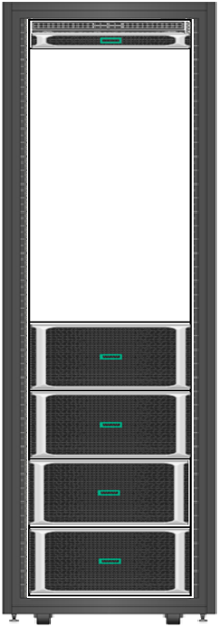
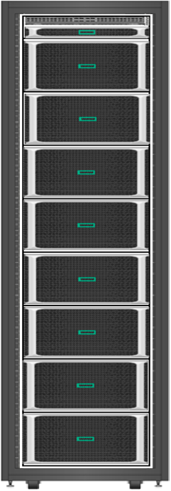
Cybersecurity Graph Analytics – reference configuration
Cybersecurity Analytics
Threat Detection Techniques
Lateral Threat Detection
Exfiltration
Command and Control
Privilege Escalation
xGT Cybersecurity Analytics Toolkit
Jupyter Notebook
Python 3.0
Per Chassis Configuration
28cores/socket = 448 cores
Processor : Cascade Lake . Xeon-Platinum 8280
Per Chassis - 16 half-height PCIe slots
3 TB DDR4 RAM per Chassis = 24 * 128GB
4 * 1.9 TB 2.5” SSD per Chassis ( For O/S + Temp files )
8 * 1.6TB / 3.2TB NVMe Card
1 * HPE Eth 10/25Gb 2p 631SFP28 Adptr per Chassis
12 Gb SAS Storage Controller
RHEL 7.6
ToR Switch
1*25GbE Switch – HPE FlexFabric 5950 48SFP28+ Switch
Monitoring/Management
1U External RMC
HPE Foundation Software ( Data Collector Daemon – Agentless Service )
HPE ISSP – InfiniteStorage Software Platform (R-Pool - HPE XFS)
 | Base Configuration | Standard Configuration | Enterprise Configuration
Scaling Cyber Graphs (Typical) | 3B Vertices / 30B Edges / 300B Properties | 6B Vertices / 60B Edges / 600B Properties | 6B Vertices / 60B Edges / 600B Properties
Total Sockets | 16 | 32 | 32
Total Cores | 448 | 896 | 896
Total Memory (TB) | 12 | 24 | 48
Total Storage NVME (TB) | 50 | 100 | 200

